Slide 1
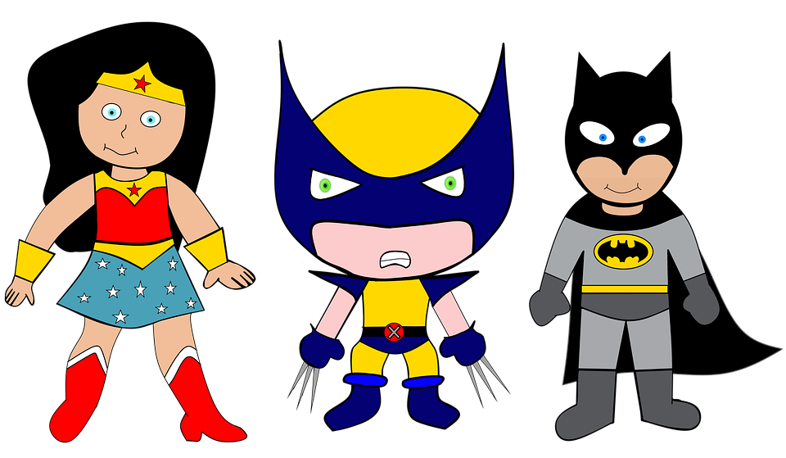
We are SUPERheroes! Students Using their Powers to Engage in Reading!
Kindergarten Newsletter – September 6-10, 2021
IMPORTANT EVENTS
Breakfast ends at 7:25! Be here early!
9/6 9/9 | No school Progress Reports
The EXPERT in anything was once a BEGINNER!
HOMEWORK
Mon. – Thurs. | Weekly ELA Sheet Math HW Pages Practice Sight Words List Read 10 minutes per night
GOOGLE CLASSROOM
Make sure your child is able to access their teacher’s Google Classroom page. If you need help, contact the teacher.
WEEKLY ASSESSMENTS
ELA | Module 1.3 test
Math | Math Lesson 4-5 test
WEEKLY MATH SKILLS
Drawing 1,2,3,4,5 Counting 1,2,3,4,5 Writing 1,2,3,4,5
REMINDERS
Please make sure all money is sent in your child’s blue folder labeled and sealed. If your child is absent, please send an excuse labeled with the following information: Child’s name, date of absence, teacher’s name, and reason for absence.
SCHOOL SAFETY
Be sure your child wears a mask to school DAILY!

Slide 2
Module 1, Week 3: Curious about Kindergarten!
LEARNING MINDSET: Curiosity
ESSENTIAL QUESTION
What will I discover in Kindergarten?
PHONICS
Introduce Letters: Qq-Zz
READING
Genre: Fiction Story Elements: Characters, Settings, Events | Listening Comprehension Parts of a Book
WORDS TO KNOW
the A see
VOCABULARY
BIG IDEA WORDS: discover, dream, partners POWER WORDS: clue, mistake, puzzled
REVIEW
Letters and sounds Aa-Ff Gg-Pp Qq-Zz
WRITING
First Name Weekly Letters Opinions
SPELLING WORDS
*Spelling words will begin in the 2nd nine weeks.
PHONEMIC AWARENESS
Identify Rhymes Identify words in a sentence

